Slide 1
Loan Default Prediction
Prediction Methods - Neural Networks

Slide 2
Contents / Agenda
Business Problem Overview & Solution Approach
Data Dictionary
Exploratory Data Analysis (EDA) Results
Data Preprocessing
Model Performance Summary
Best Model Selection
Conclusions & Recommendations
Appendix / Screenshots

Slide 3
Data Dictionary
The data contains different attributes of customers’ loan and credit details. The detailed data dictionary is given below:
BAD: Whether the client defaulted on the loan (0 = No, 1 = Yes)
LOAN: Amount of loan approved
MORTDUE: Amount due on the existing mortgage
VALUE: Current value of the property
REASON: Reason for the loan request (HomeImp = Home Improvement, DebtCon = Debt Consolidation)
JOB: Type of job the applicant has (e.g., Manager, Self-employed)
YOJ: Years at present job

Slide 4
Data Dictionary
DEROG: Number of major derogatory reports (serious delinquency/late payments)
DELINQ: Number of delinquent credit lines (past due payments)
CLAGE: Age of the oldest credit line in months
NINQ: Number of recent credit inquiries
CLNO: Number of existing credit lines
DEBTINC: Debt-to-income ratio (all monthly debt payments divided by gross monthly income)

Slide 5
Business Problem Overview and Solution Approach
The Problem: The retail bank faces critical financial risk derived from Non-Performing Assets (NPAs), which directly erode the profitability of the mortgage portfolio. The current approval process is manual, inefficient, and vulnerable to human bias, preventing an objective risk assessment and hindering regulatory compliance (Equal Credit Opportunity Act).
Solution Approach: To mitigate this risk, an analytical strategy based on historical data has been implemented to transition towards an automated decision-making system. The solution consists of the development of a Neural Network model capable of detecting complex non-linear default patterns, which can additionally be analyzed to justify loan rejections for regulatory compliance.

Slide 6
Business Problem Overview and Solution Approach
A credit risk predictive model was developed using RapidMiner, starting with advanced data preprocessing that included missing value imputation via k-Nearest Neighbors (k-NN), feature engineering to capture debt concealment behaviors, and variable normalization.
The core analysis focused on training Neural Networks in three phases:
First: Establishing a baseline model to define the general architecture.
Second: Developing a model optimized through parameter tuning.
Third: Implementing a model that incorporates automatic optimization (Grid Search) and Cross-Validation to ensure statistical stability.
Ultimately, the models were compared to select the best performer and derive significant insights.

Slide 7
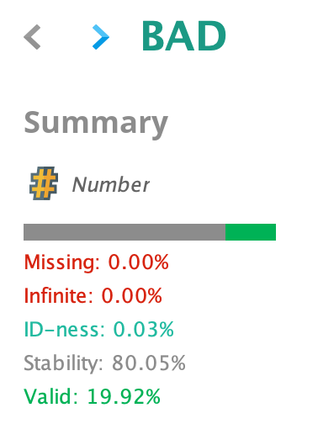
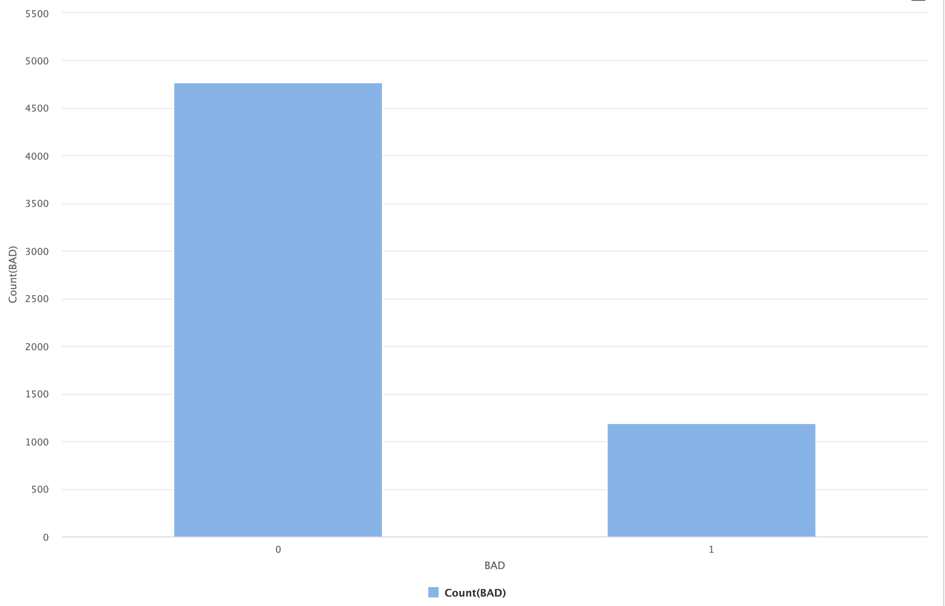
Exploratory Data Analysis
Reveals an expectedly imbalanced distribution, with a default prevalence of 19.9%.

Slide 8
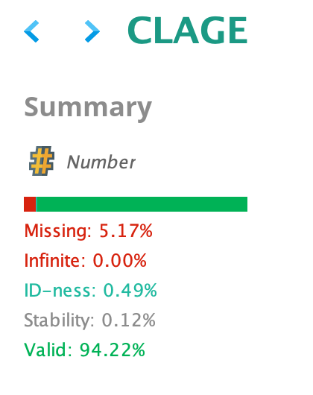
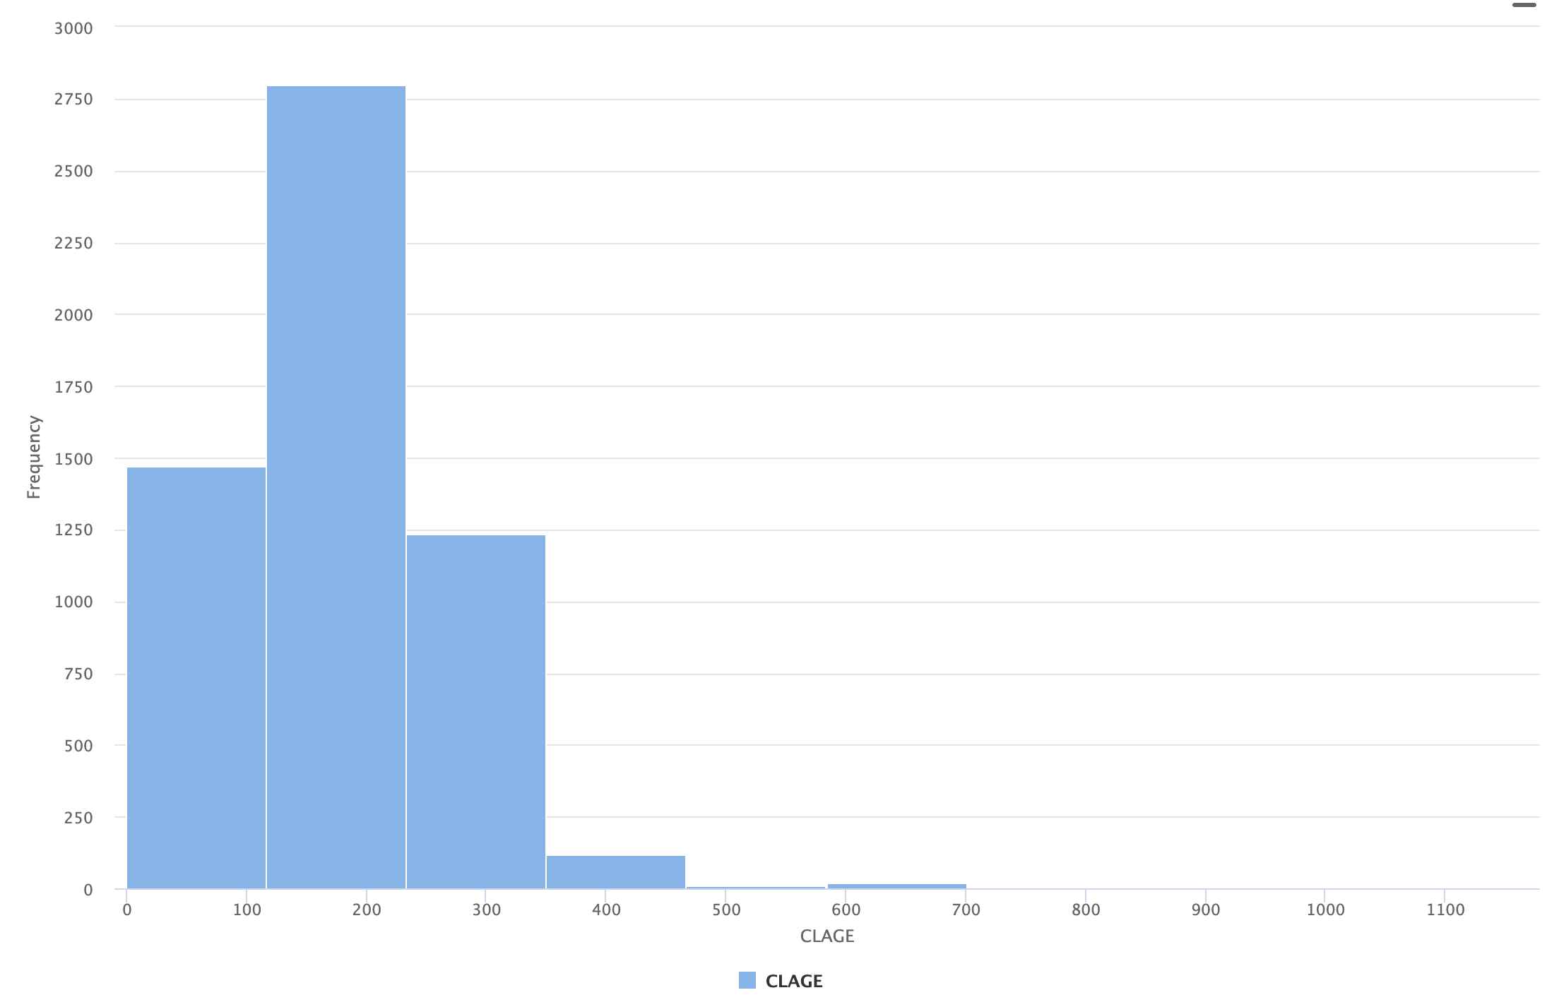
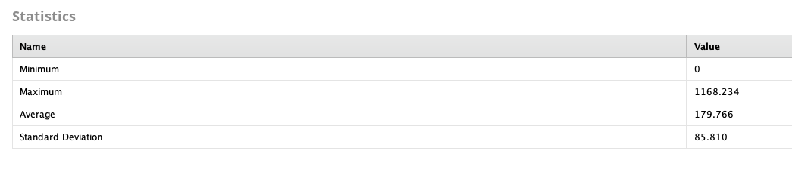
It is vital to impute missing values.
Addressing outliers is critical because neural networks are hypersensitive to extreme scales.

Slide 9
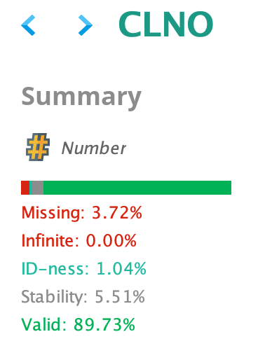
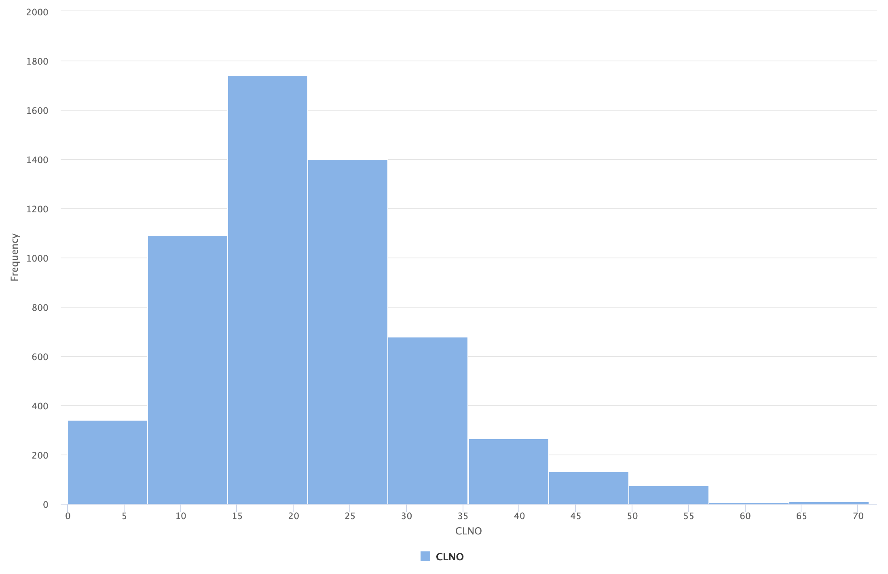
The CLNO variable has a quasi-normal distribution favorable for modeling, requiring only a simple imputation of missing values ​​(3.72%) and normalization.

Slide 10
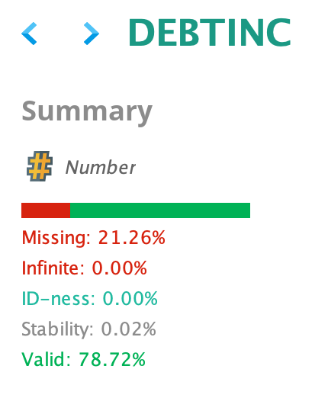
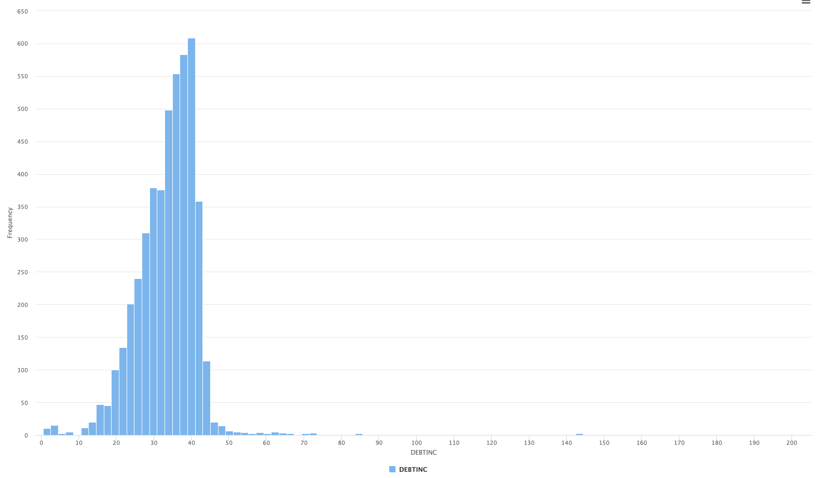
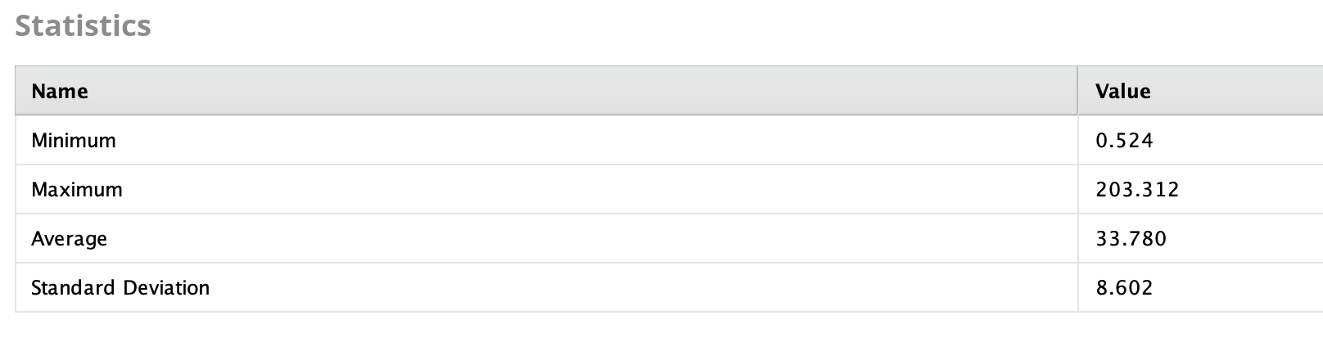
There are outliers that act as statistical noise, representing errors or anomalous situations that do not reflect real market behavior and distort the model.
Additionally, a significant amount of missing data has been identified.

Slide 11
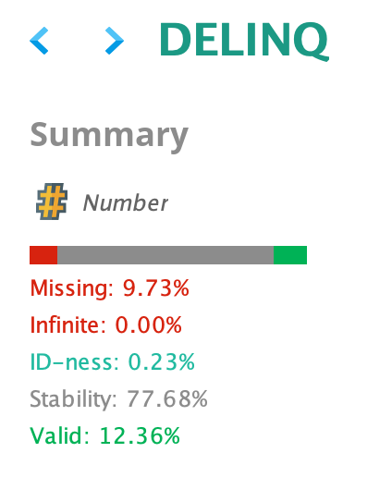
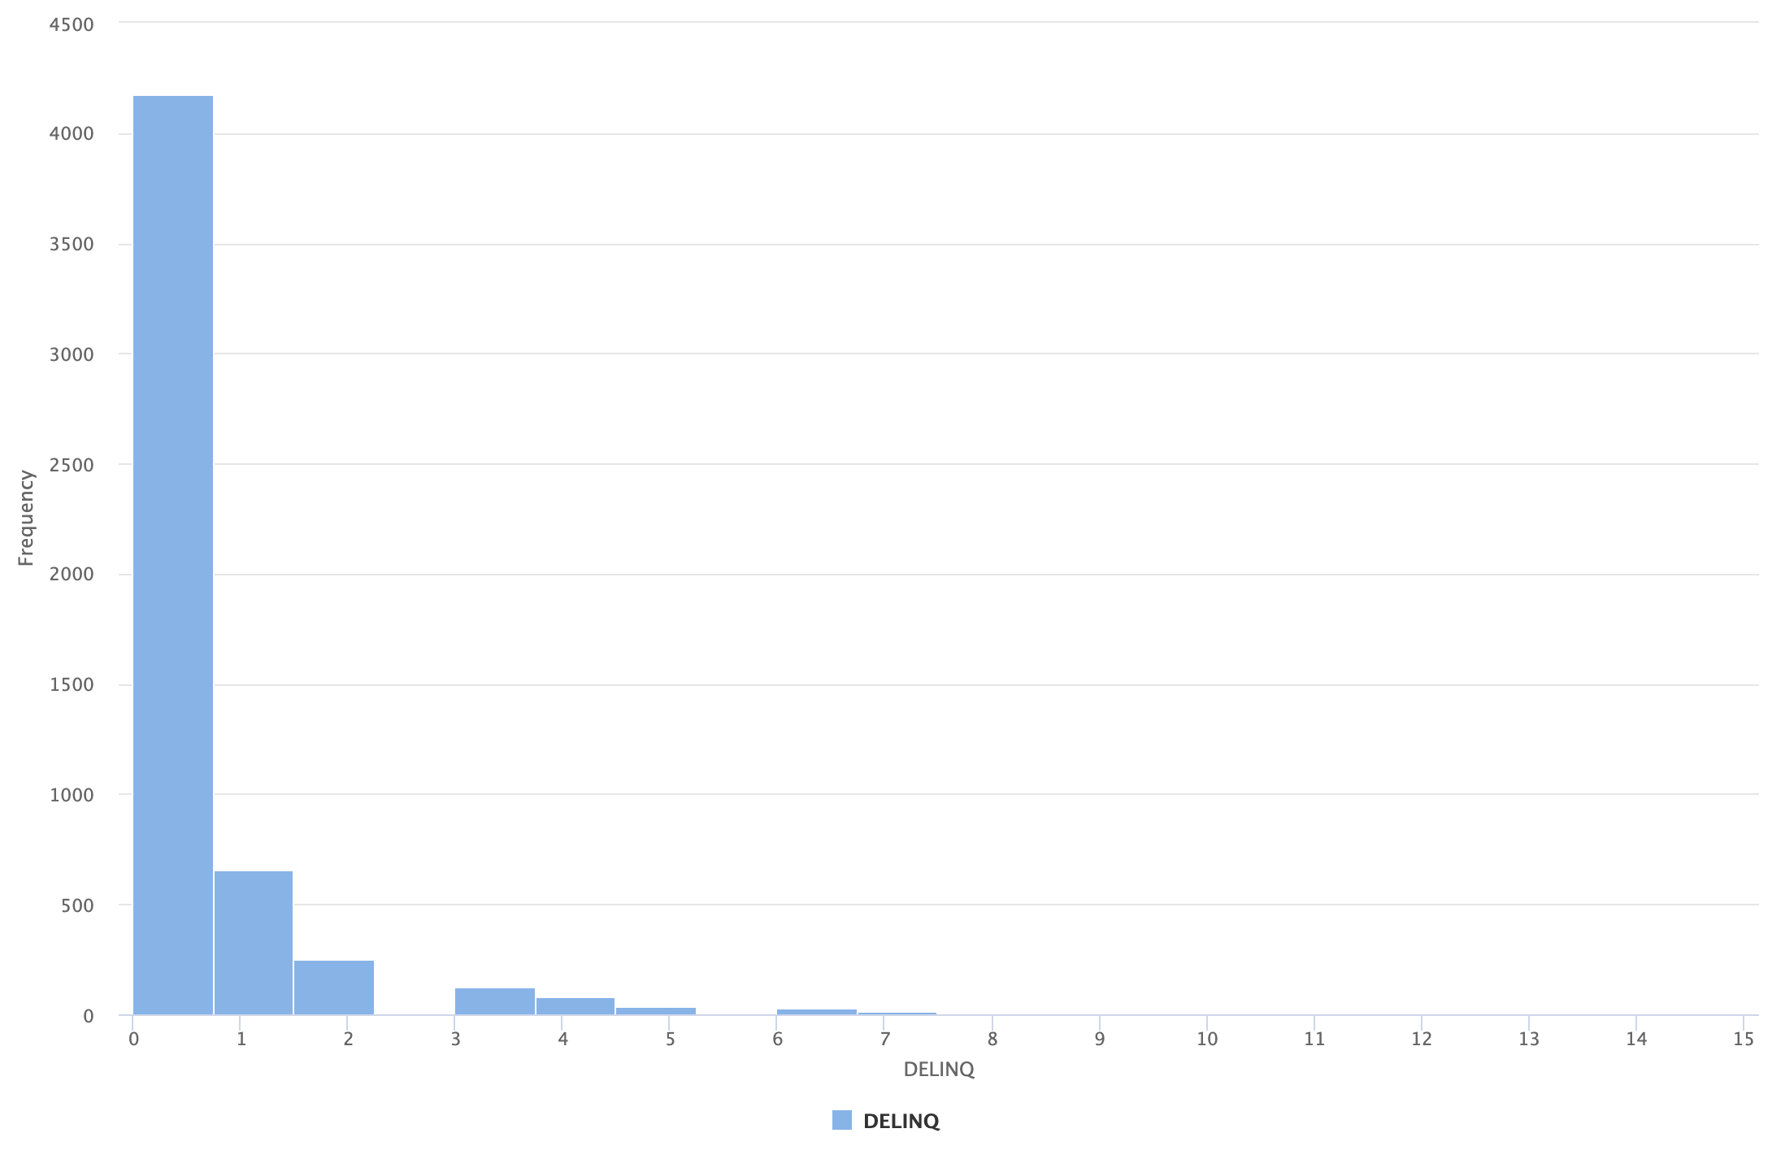
The distribution is highly skewed, as expected with zero inflation, indicating that most applicants have no history of default.
Additionally, a significant amount of missing values was identified.

Slide 12
Summary of Initial EDA
It is vital to impute or fill in missing values ​​because Neural Networks do not process null inputs. Filling in this data ensures the technical feasibility of the matrix calculation without sacrificing valuable sample information. To do this, each variable will undergo an analysis to determine how to maintain objectivity as much as possible and avoid introducing bias into the model.
The variables need to be standardized/normalized due to their large variance differences. These values ​​must be transformed to prevent them from distorting the weights and the learning of general patterns.
It is positive to confirm that the LOAN variable has no missing values ​​because knowing the loan amount for each client is essential for model development.

Slide 13
Statistics after Preprocessing:
For JOB variable, the ”Desconocido" category was created for missing values.
For the DELINQ, DEROG, and NINQ variables, missing values ​​were filled with 0. This is because if a client has no negative records, a certain degree of bank innocence is assumed.
The VALUE, MORTDUE, DEBTINC, CLAGE, CLNO, and YOJ variables were correlated with LOAN using K-NN. Additionally, an attribute, DEBTINC_Flag, was created to identify clients whose data is not declared in DEBTINC.
Capping was performed on the CLAGE, DEBTINC, and DELINQ variables to eliminate outliers that negatively affect the normalization process.
Finally, the data was normalized using the Z-transformation.

Slide 14
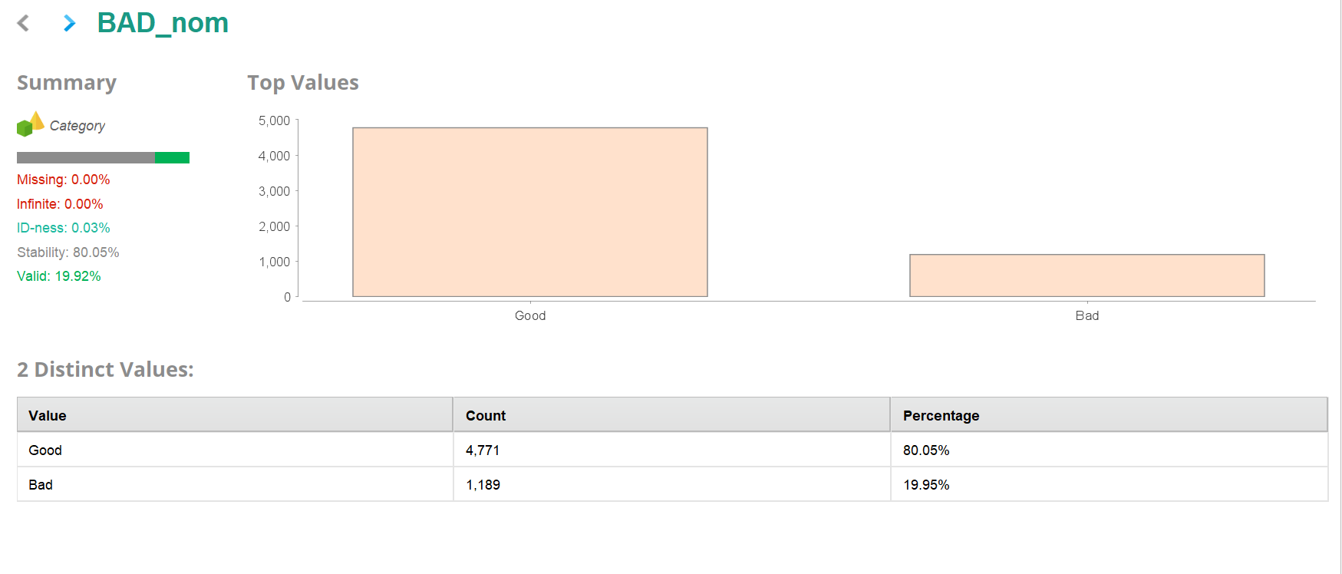
Statistics after Preprocessing:
This is the label variable, similar to BAD but categorical.

Slide 15
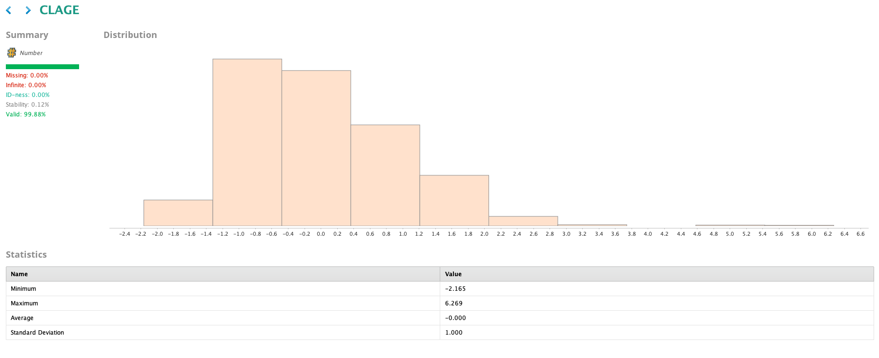
Missing values ​​were filled using K-NN. A cap was applied to the value 700, and the data was then normalized to avoid "squashing" the data.

Slide 16
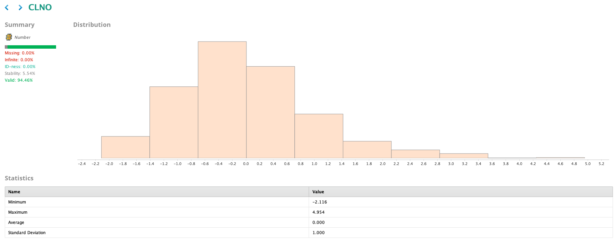
Data imputation and normalization were performed.

Slide 17
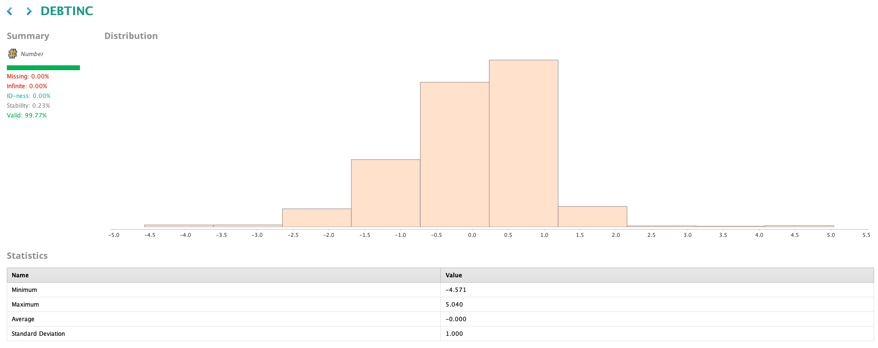
Data was imputed using K-NN, capped at the value 70, and then normalized.
An attribute was created to identify customers with missing data.

Slide 18
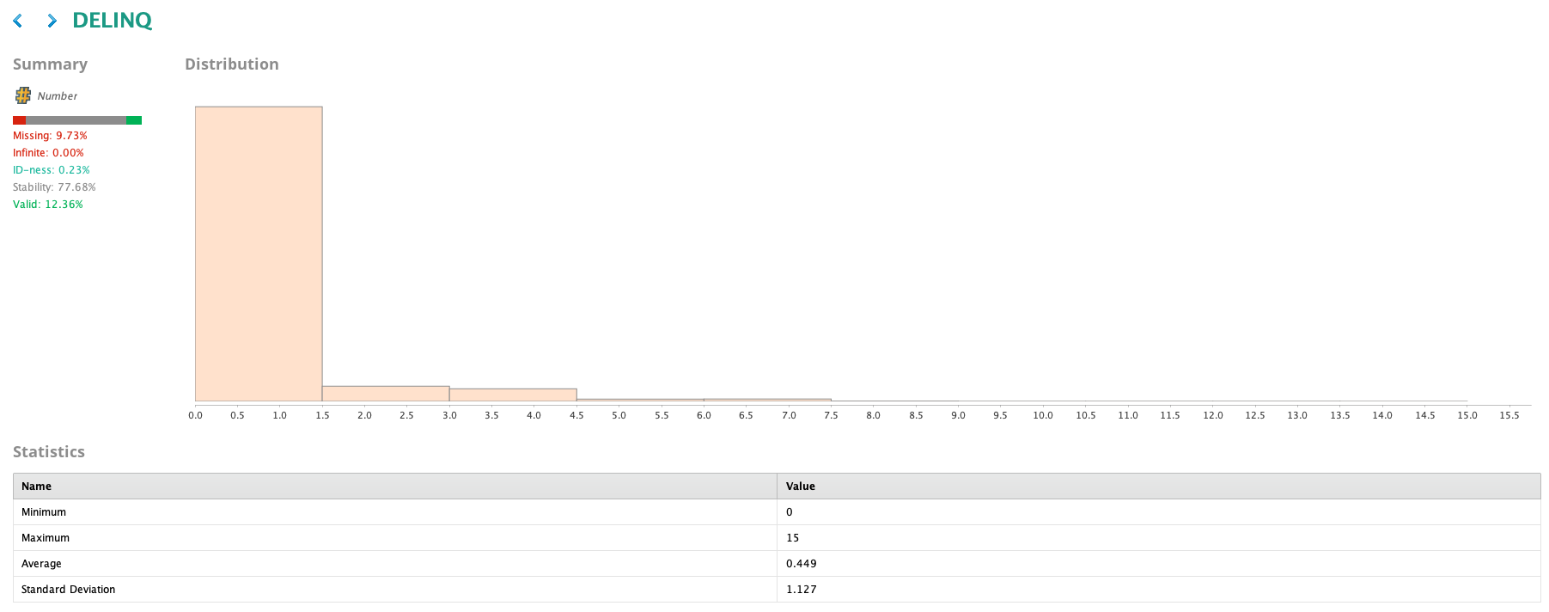
Data imputation was performed using K-NN, capping at the value 3, and then normalization.

Slide 19
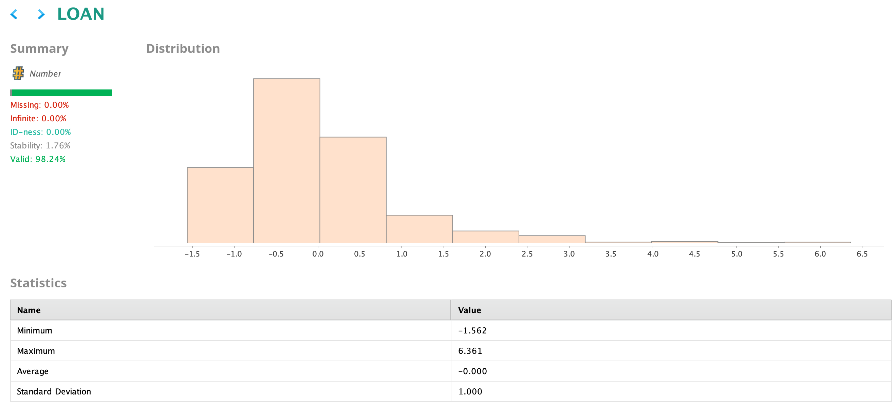
A necessary normalization of the variable was performed.

Slide 20
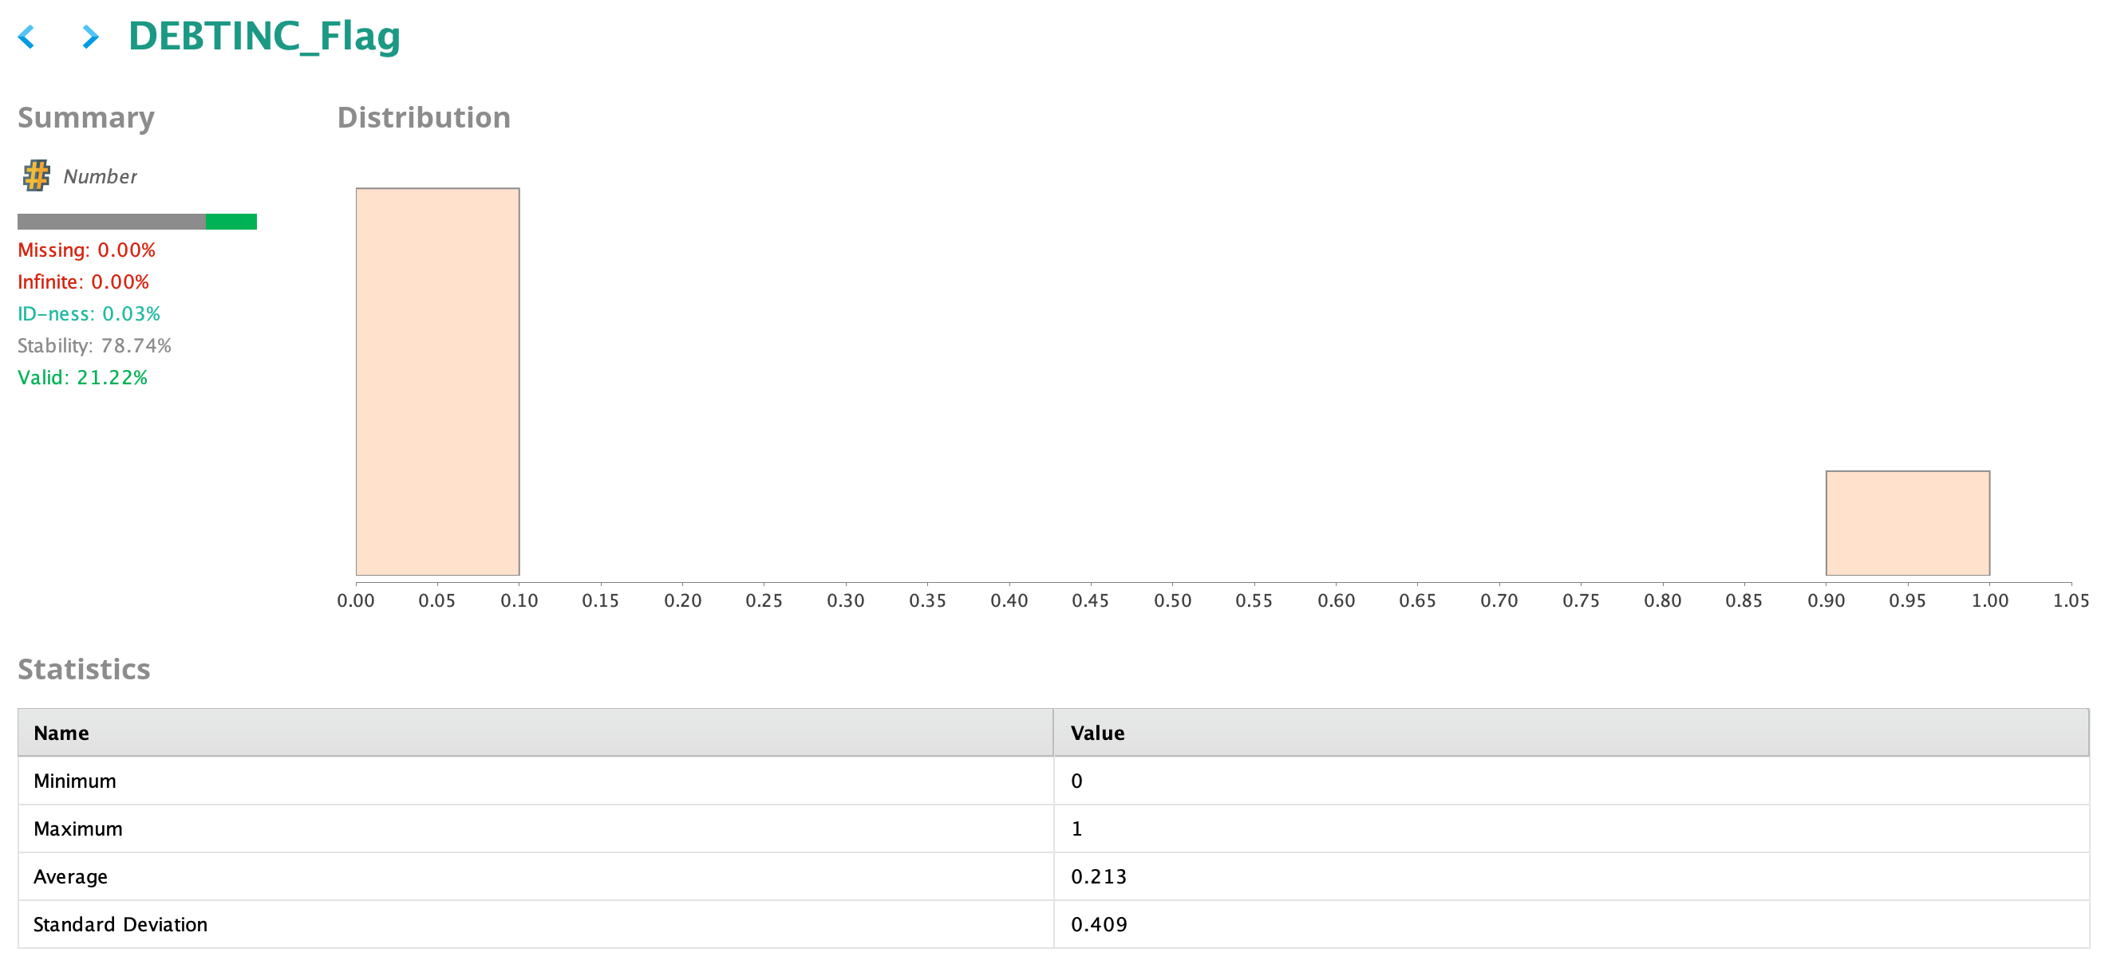
This “flag” variable was created so that the model could identify customers who did not have data in the DEBTINC variable, those who were imputed by k-NN

Slide 21
Phase 1: Basic Neural Network
The results are positive, but there's significant room for improvement.
The model is generally good at identifying paying customers, but it struggles to identify non-paying customers, which is crucial for this business.
The kappa value is moderate and needs to be higher to confirm that the model isn't random.
Metric | Accuracy | Kappa | Weighted Recall | Weighted Precision
Basic Neural Network | 88.70 | 0.627 | 79.70 | 83.37

Slide 22
Phase 2: Neural Network With Parameter Tuning
With a slight increase in the depth of the neural network, where hidden layers were added, the results are positive and are better consolidated as a realistic model. However, it is necessary to verify whether this model is overfitting the training data.
The model has successfully detected 80% of the debtors, in addition to having a near 90% accuracy rate.
The kappa value has improved slightly.
Metric | Accuracy | Kappa | Weighted Recall | Weighted Precision
Neural Network with Parameter Tuning | 89.09 | 0.650 | 81.73 | 83.38

Slide 23
Phase 3: Neural Network Using Grid Search
The introduction of cross-validation has reduced the model's performance. This isn't necessarily negative, as the model has now been validated and can perform better in a real-world environment, rather than being overfitted to the training data.
Despite its generally good performance, the model requires refinement to improve the detection of bad customers without penalizing good ones.
Metric | Accuracy | Kappa | Weighted Recall | Weighted Precision
Grid Search Optimized Model | 88.26 | 0.614 | 79.21 | 82.48

Slide 24
Model Performance Summary
The Grid Search Optimized Model (Phase 3) is selected. Although its metrics are slightly lower than the manual model, this model has been validated using cross-validation (10-fold). This ensures that it is mathematically robust, stable, and not overfitted to a specific data sample, which is critical to avoid losses of millions in a real-world environment.
The critical metric is the Recall (Sensitivity) of the "BAD" Class. The cost of approving a loan for a customer who will not repay is vastly greater than the cost of reviewing a doubtful customer. Maximizing the Recall protects the bank's capital.
Metric | Accuracy | Kappa | Weighted Recall | Weighted Precision
Without parameter tuning | 88.70 | 0.627 | 79.70 | 83.37
With parameter tuning | 89.09 | 0.650 | 81.73 | 83.38
Grid Search Optimized Model | 88.26 | 0.614 | 79.21 | 82.48

Slide 25
Conclusions and Recommendations
Attribute engineering demonstrated that the absence of debt information (DEBTINC unknown) is a risk pattern in itself. Flagging these cases improved the model's detection capability.
Cross-validation revealed that simple models can create a false sense of success. The final model, although more conservative, is statistically reliable.
The success of the neural network (Kappa > 0.60) confirms that credit risk does not depend on a single rule, but rather on complex interactions between debt age, payment behavior, and debt.
Implement the model with a cost-sensitive learning (MetaCost) strategy. It is recommended to configure the model to penalize default errors more frequently. This will slightly sacrifice overall accuracy but will increase the capture of delinquent accounts, aligning with the financial risk mitigation strategy.

Slide 26
APPENDIX

Slide 27
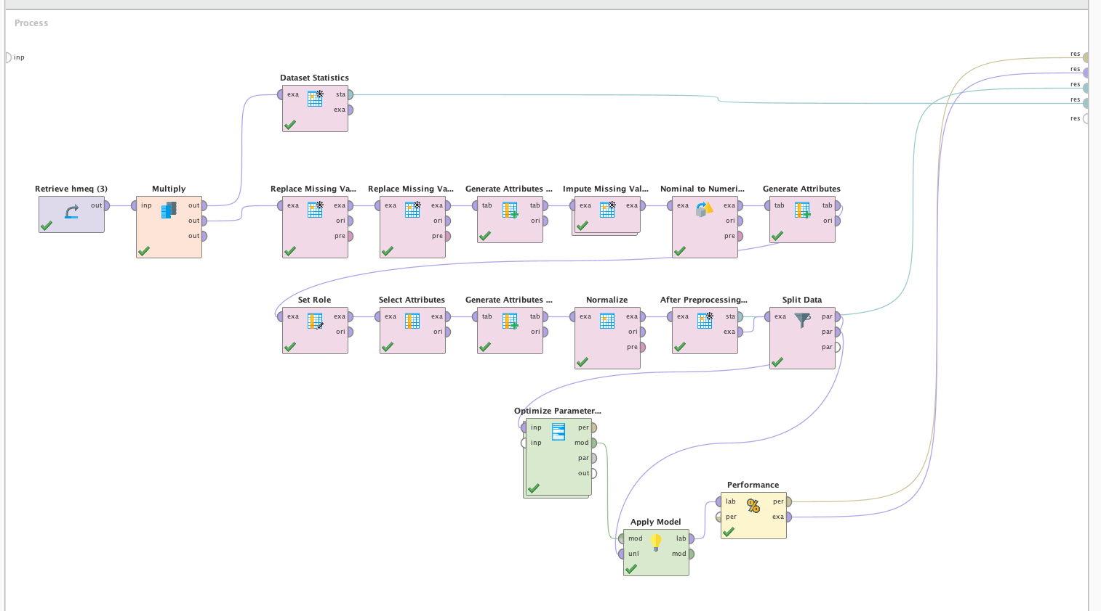
RM Process

